Slide 1
NEXT-GEN GROUND SEGMENT
coming soon….

Slide 2
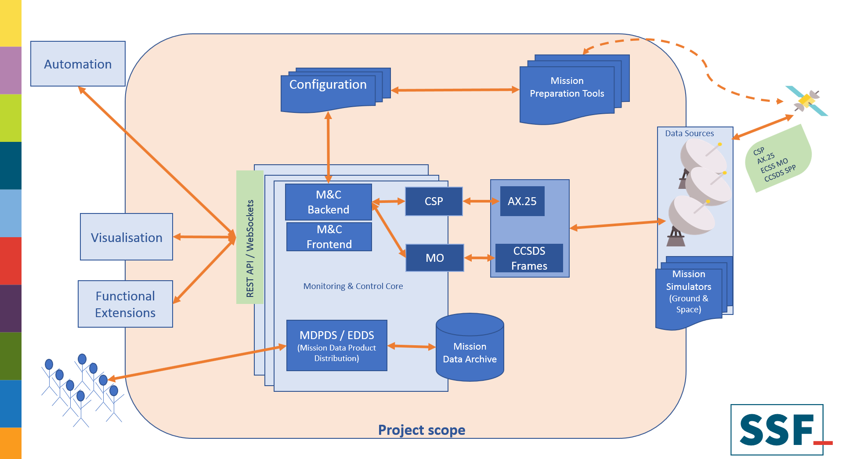
Notes:
GS application infrastructure
Do wee need another MCS? Bringing knowledge, listen to community, cooperate with UWB VZLUSAT-1
Basic building blocks on picture,
Why different
We customize ESA existing application for cubesat operation needs
Will provide modern interfaces
From the beginning -> CSP, MO but more rolled out in later phases
First natively MO (OPS-SAT)
Functional extensions – inspiration from yesterday -> initial tracking after orbit insertion

Slide 3
Thank you
http://www.spacesystems.cz

